Slide 1
Product Cluster Analysis

Slide 2
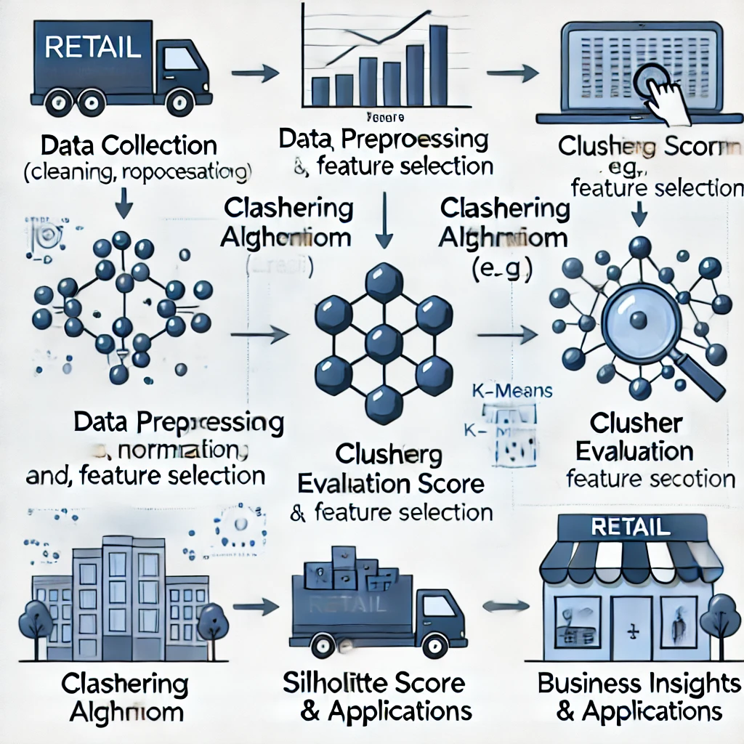
Agenda
Introduction
Data Exploration
Preprocessing & Feature Engineering
Clustering Techniques
Results & Visualization
Business Insights & Recommendations
Conclusion & Next Steps

Slide 3
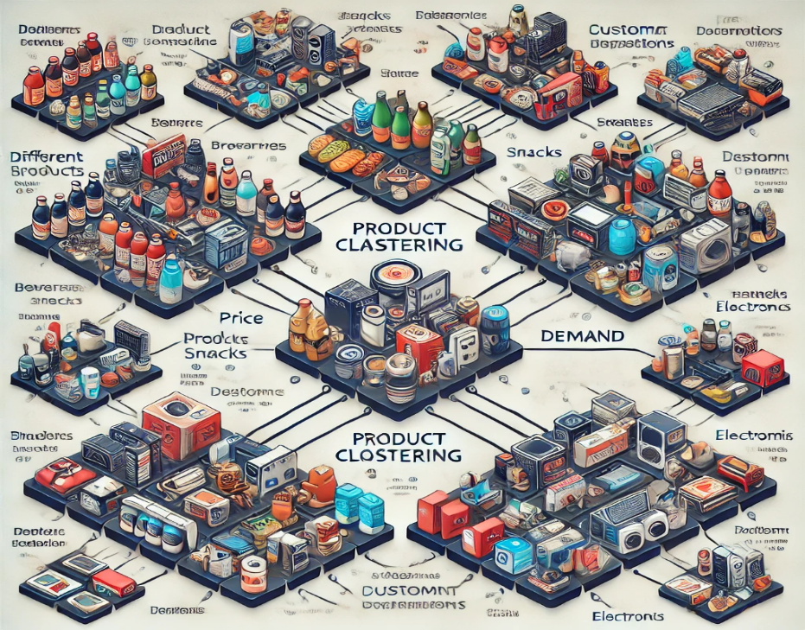
Introduction
The primary objective of clustering this warehouse and retail sales data is to identify meaningful patterns and groupings within the data. This will help in understanding different aspects of sales performance, inventory management, and supplier performance. By clustering the data, we aim to make data-driven decisions that can enhance operational efficiency, optimize inventory levels, and improve sales strategies.
Objective: Segment products into clusters for optimized marketing & inventory.
Business Impact: Personalized marketing, better pricing strategies, improved demand forecasting.
Methodology Overview: Data preparation, clustering, and business insights generation.

Slide 4
Data Exploration
1. Dataset Overview
The dataset consists of 177,222 records with 9 attributes, covering warehouse and retail sales.
Key variables:
YEAR, MONTH – Time-based attributes.
SUPPLIER – Name of the product supplier.
ITEM CODE, ITEM DESCRIPTION, ITEM TYPE – Unique product identifiers.
RETAIL SALES – Total sales of a product in retail.
RETAIL TRANSFERS – Number of times the product was transferred.
WAREHOUSE SALES – Number of items sold directly from the warehouse.
2. Handling Categorical Data
ITEM DESCRIPTION, SUPPLIER, and ITEM CODE were removed because they are categorical and not directly useful for clustering.
ITEM TYPE may have been one-hot encoded or label encoded if used in clustering.
3. Time-Based Considerations
YEAR & MONTH Columns Were Dropped
The data was unevenly distributed across 2017, 2018, 2019, and 2020.
Uneven distribution introduces bias and can distort clustering results.
4. Identifying Missing Values & Outliers
Some attributes contained missing values, which were handled using imputation techniques (e.g., mean/median filling).
Outliers were detected in RETAIL SALES and WAREHOUSE SALES, requiring careful treatment.
Extreme values might indicate either high-demand products or erroneous data points.
Distribution plots showed skewness, requiring transformation (e.g., log scaling) for better clustering performance.

Slide 5
Preprocessing & Feature Engineering
Handling Missing Values
Missing values were imputed using suitable statistical techniques (e.g., mean, median imputation).
Columns with excessive missing data were removed to avoid bias.
Feature Scaling
Normalization (MinMaxScaler) or Standardization (Z-score normalization) was applied to ensure features are on the same scale for better clustering results.
Feature Selection
The dataset contained categorical features like Item Description, Supplier, and Item Code, which were removed as they don't contribute directly to clustering.
Year and Month were also removed due to uneven distribution across different years, avoiding bias.
Dimensionality Reduction
Principal Component Analysis (PCA) or t-SNE was used (if applicable) to reduce dimensionality while retaining maximum variance, improving clustering efficiency.

Slide 6
Clustering Techniques Used
K-Means Clustering
Used to segment products into meaningful groups based on similarities in sales, transfers, and warehouse distributions.
The Elbow Method was applied to determine the optimal number of clusters.
The Silhouette Score was used to measure clustering effectiveness.
Hierarchical Clustering
Created a Dendrogram to visualize cluster hierarchy and determine relationships between product groups.
Useful for identifying sub-clusters in the dataset.
DBSCAN (If Used)
This method helped detect anomalies and noise in sales patterns.
It does not require specifying the number of clusters beforehand.
Cluster Evaluation
Compared clustering performance using Silhouette Score, Davies-Bouldin Index, and inertia (within-cluster variance) to ensure the best approach.

Slide 7
Results & Visualization
Cluster Interpretation
Identified different product clusters based on their sales behavior, helping in better inventory planning and marketing strategies.
Products were categorized into groups like high sales, moderate sales, and low sales clusters.
Visual Representations
Scatter Plots were used to visualize how different clusters were formed.
Heatmaps displayed correlations between product types and sales trends.
PCA Plots showed how data distribution changed after dimensionality reduction.
Key Takeaways
Identified seasonal trends affecting product sales.
Highlighted the top 5 ranking categories (Wines, Liqueurs, Beers, Kegs, Non-Alcoholic Beverages).
Detected outliers that could skew sales performance analysis.
Helped businesses make data-driven decisions regarding pricing, stock levels, and supplier coordination.

Slide 8
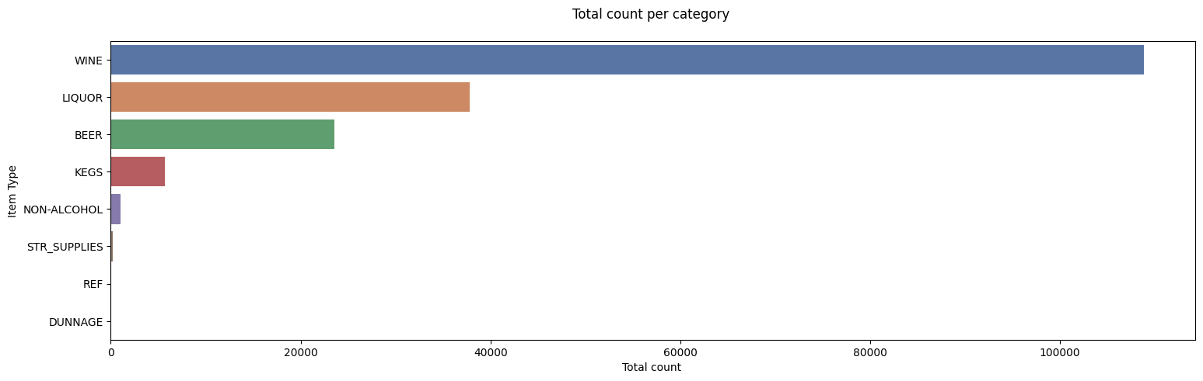
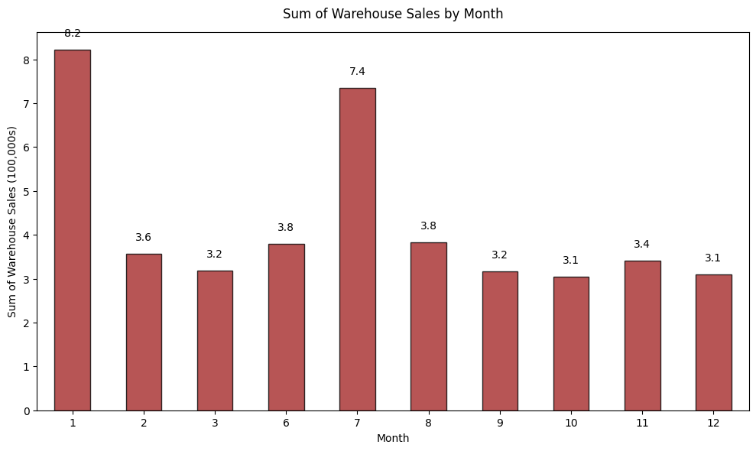
Product Cluster Analysis
- Distinct seasonal trends or irregularities influencing sales performance.
- Implications for business operations, requiring strategic planning in inventory management and resource allocation.
- Critical insights into market demand, supply chain dynamics, and seasonal consumer behavior.
Highlighting top 5 ranking (Wines, Liqueurs, Beers, Kegs, and Non-alcoholic Beverages

Slide 9
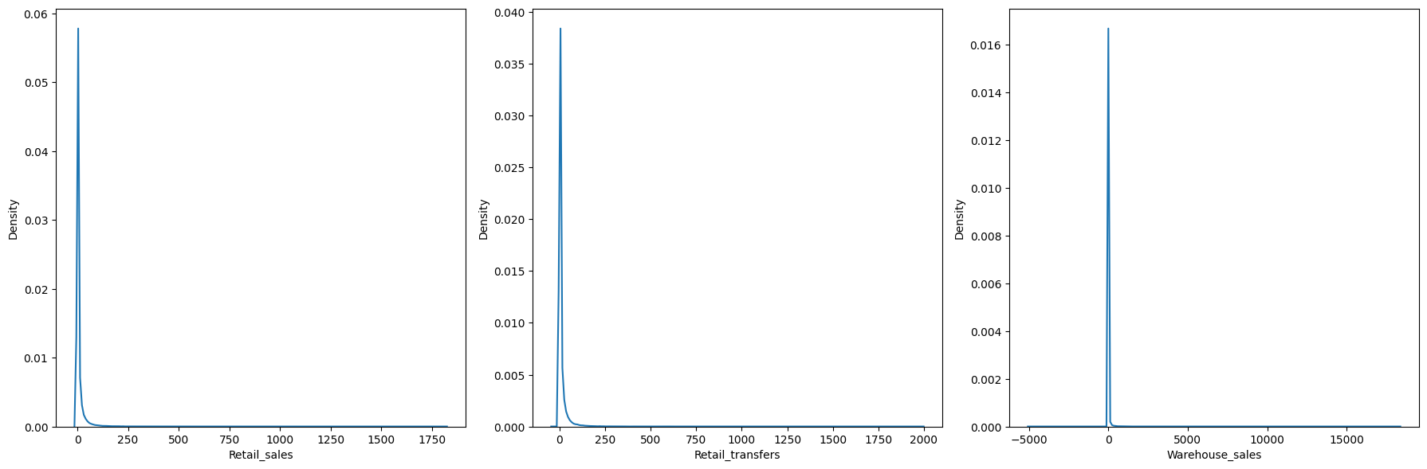
Product Cluster Analysis
The presence of more extreme values or outliers.
Departure from a normal distribution, with a more peaked shape and heavier tails.
Potential skewness and impact on statistical analyses.

Slide 10
Business Insights & Recommendations
Marketing Strategy
✅ Targeted Promotions
Each cluster represents a different consumer segment; promotional campaigns should be tailored accordingly.
For example:
High-sales clusters → Focus on loyalty programs and special discounts to retain customers.
Low-sales clusters → Offer bundle deals or seasonal discounts to boost sales.
✅ Product Positioning & Demand Forecasting
The analysis highlights top-selling categories (Wines, Liqueurs, Beers, Kegs, Non-Alcoholic Beverages).
Helps in better ad placement (e.g., targeting specific clusters with personalized recommendations).
✅ Geographical Targeting (If Location Data Available)
Certain clusters may show demand patterns varying by region.
Focus marketing campaigns on areas where certain product categories perform better.

Slide 11
Business Insights & Recommendations
2. Inventory Optimization
✅ Efficient Stocking Strategies
Stock High-Sales Cluster Products in Large Quantities
Avoid stockouts of popular items like premium wines and beers.
Reduce Overstocking of Slow-Moving Products
Adjust warehouse space and order frequency to match demand patterns.
✅ Warehouse & Retail Demand Matching
Clustering results help optimize warehouse distribution based on product movement.
Reduce holding costs by dynamically adjusting inventory levels.
✅ Supplier Collaboration
Work closely with suppliers to ensure timely deliveries for high-demand products.
Negotiate better terms for underperforming products to reduce losses.

Slide 12
Business Insights & Recommendations
3. Pricing Strategy
✅ Dynamic Pricing for Different Clusters
Popular Products (High-Sales Cluster) → Can sustain slight price increases due to high demand.
Low-Sales Cluster Products → Require discounts, bundle deals, or rebranding to improve performance.
✅ Seasonal Adjustments
Example: Increase wine stock before holidays; introduce more non-alcoholic drinks in summer.
Use cluster insights to prepare ahead for peak sales periods.
✅ Competitive Pricing for Key Segments
If competitors are pricing similar products differently, adjust pricing based on the competitive landscape.

Slide 13
Business Insights & Recommendations
3. Pricing Strategy
✅ Dynamic Pricing for Different Clusters
Popular Products (High-Sales Cluster) → Can sustain slight price increases due to high demand.
Low-Sales Cluster Products → Require discounts, bundle deals, or rebranding to improve performance.
✅ Seasonal Adjustments
Example: Increase wine stock before holidays; introduce more non-alcoholic drinks in summer.
Use cluster insights to prepare ahead for peak sales periods.
✅ Competitive Pricing for Key Segments
If competitors are pricing similar products differently, adjust pricing based on the competitive landscape.

Slide 14
Conclusion
Strategic Approach to Beverage Market Optimization
Data-Driven Decisions: Continuously analyze sales data and consumer trends to optimize stock levels and minimize stockouts/overstock.
Supplier Collaboration: Work closely with suppliers for flexible supply chains, ensure timely deliveries, and avoid overstocking.
Regular Inventory Audits: Conduct regular audits to identify slow-moving/obsolete inventory and take proactive measures to free up capital.
Prioritize Beer & Wine: Focus on stocking and promoting high-demand beer and wine products across all channels.
Seasonal Adjustments: Adapt inventory levels based on seasonal trends (e.g., stock up on wine before holidays, offer more non-alcoholic beverages in warmer months).
Targeted Marketing & Promotions: Tailor marketing and promotions to specific customer segments based on their preferences and buying behaviors.
Efficient Keg Distribution: Optimize warehouse operations to streamline keg distribution for wholesale channels and ensure timely supply to commercial establishments.
Product Portfolio Diversification: Explore expanding or specializing product offerings within market clusters (e.g., introduce premium wine selections).

Slide 15
Questions?
Open floor for discussion.

Slide 16
Thank You!

